Slide 1


Binary trees: introduction (complete and extended binary trees),
Memory representation (sequential, linked)
Binary tree traversal: pre-order, in-order and post-order (traversal algorithms using stacks)

Slide 2


A tree is a finite set of zero or more nodes
such that:
There is a specially designated node called
the root.
The remaining nodes are partitioned into n>=0 disjoint sets T1, ..., Tn, where each of these sets is a tree.
We call T1, ..., Tn the subtrees of the root.

Slide 3
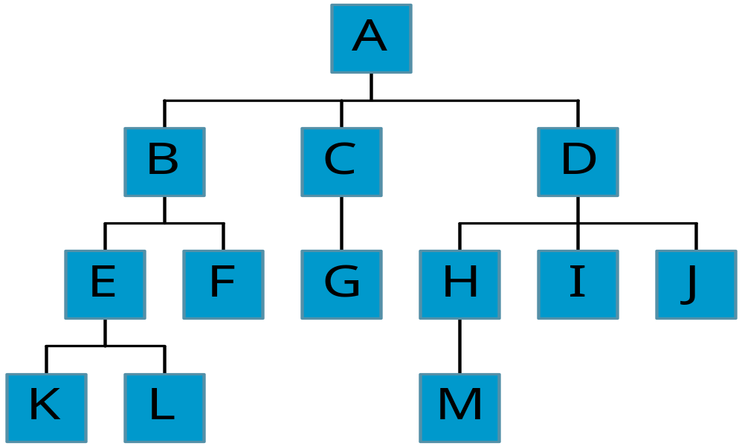
Level and Depth
node (13)
degree of a node(shown by green number)
leaf (terminal)
nonterminal
parent
children
sibling
level of a node
height(depth)
of a tree (4)
Level
0
1
2
3
3
2
1
3
2
0
0
1
0
0
0
0
0

Slide 4
Terminology
The degree of a node is the number of subtrees
of the node
  The degree of A is 3; the degree of C is 1.
The node with degree 0 is a leaf or terminal
node.
A node that has subtrees is the parent of the
roots of the subtrees.
The roots of these subtrees are the children of
the node.
Children of the same parent are siblings.

Slide 5
Tree Properties
Property Value
Number of nodes
Height
Root Node
Leaves
Interior nodes
Number of levels
Ancestors of H
Descendants of B
Siblings of E
degree of node A
A
B
C
D
E
F
G
H
I

Slide 6
Binary Trees
A special class of trees: max degree for each node is 2
Recursive definition: A binary tree is a finite set of nodes that is either empty or consists of a root and two disjoint binary trees called the left subtree and the right subtree.

Slide 7
A binary tree
1. is either an empty tree or
2. consists of a node, called root, and two children, left and right, each of which is itself a binary tree.

Slide 8

A
B
E
C
G
D
K
F
H
L
M
I
J

Slide 9
Samples of Trees
A
A
Complete Binary Tree
A
B
B
Skewed Binary Tree
C
B
C
D
D
E
F
G
E
H
I

Slide 10
Nodes with degree=0 are called __
A. terminal
B. Non Terminal
C. Parent
D. Children

Slide 11
Maximum Number of Nodes in BT
The maximum number of nodes on level i of a binary tree is 2^{i}, i>=0.
The maximum number of nodes in a binary tree of depth k is 2^{k}-1, k>=1.

Slide 12
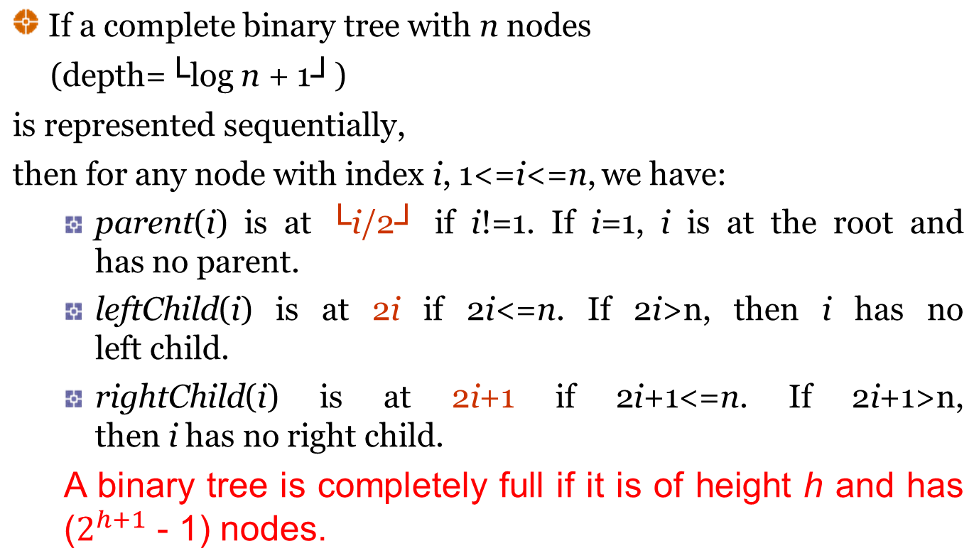
Complete Binary Tree

Slide 13
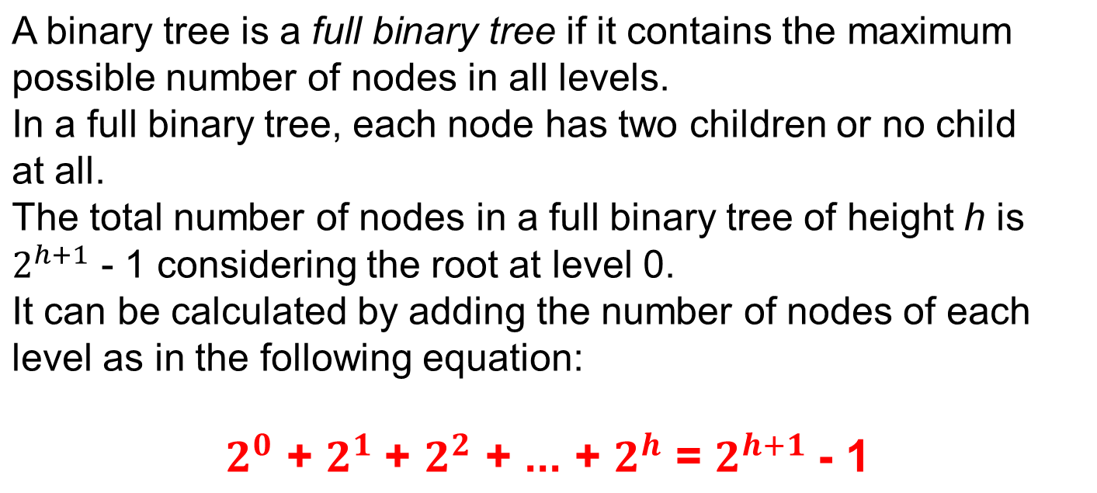
Full Binary Tree

Slide 14
Full BT vs. Complete BT
A full binary tree of depth k is a binary tree of depth k having 2^{k}-1 nodes, k>=1.
A binary tree with n nodes and depth k is
complete iff its nodes correspond to the nodes numbered from 1 to n in the full binary tree of depth k.
A
A
B
C
B
C
D
E
F
G
D
E
F
G
H
H
I
J
K
L
M
N
O
I
Complete binary tree
Full binary tree of depth 4

Slide 15
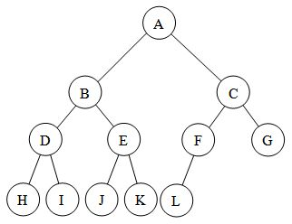
Complete Binary Tree
Full Binary Tree
A
B
C
D
E
F
G
H
I
J
K
L
M
N
O

Slide 16
The maximum number of nodes in a binary tree of depth n is where n>=1
2^{n}-1
2n-1
2^{n}
2^{n}+1

Slide 17
Extended Binary Tree
A binary tree T is said to be a 2-tree or an extended binary tree if each node N has either 0 or 2 children.
The nodes with 2 children are called internal nodes.
The nodes with o children are called external nodes.
A
A
B
C
B
C
D
F
D
F
G
G
Fig: Binary Tree T
Fig: Extended 2-tree

Slide 20
[1]
[2]
[3]
[4]
[5]
[6]
[7]
[8]
[9]
A
B
C
D
E
F
G
H
I
Sequential Representation
[1]
[2]
[3]
[4]
[5]
[6]
[7]
[8]
[9]
.
[16]
A
B
--C
--
--
--
D
--
.
E
(1) waste space
(2) insertion/deletion
problem
A
B
A
C
B
C
D
D
E
F
G
E
H
I

Slide 21
Linked Representation
struct btnode {
int data;
btnode *left, *right;
};
data
left
data
right
left
right

Slide 22
Binary Tree Traversals
There are three standard ways of traversing a binary tree T with root R.
These three algorithms, called:
  preorder
  inorder
  postorder

Slide 24
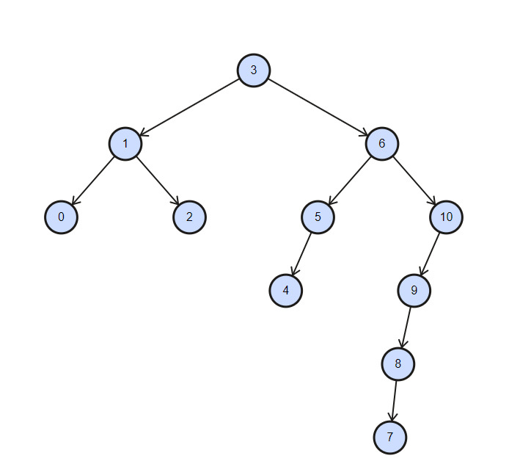

Slide 25
Arithmetic Expression Using BT
+
preorder traversal
+ * * / A B C D E
prefix expression
inorder traversal
A / B * C * D + E
infix expression
postorder traversal
A B / C * D * E +
postfix expression
*
E
*
D
/
C
A
B

Slide 26
Preorder Traversal (recursive version)
Algorithm:
1. Process the root R.
2. Traverse the left subtree of R in preorder.
3. Traverse the right subtree of R in preorder.
Pseudo-Code:
void preorder(btnode ptr)
/* preorder tree traversal */
{
if (ptr!=NULL) {
cout<<ptr->data;
preorder(ptr->left);
predorder(ptr->right);
}
}
+ * * / A B C D E

Slide 27
Inorder Traversal (recursive version)
Algorithm:
1. Traverse the left subtree of R in inorder.
2. Process the root R.
3. Traverse the right subtree of R in inorder.
Pseudo-Code:
void inorder(btnode ptr)
/* inorder tree traversal */
{
if (ptr!=NULL) {
inorder(ptr->left);
cout<<ptr->data;
indorder(ptr->right);
}
}
A / B * C * D + E

Slide 28
Postorder Traversal (recursive version)
Algorithm:
1. Traverse the left subtree of R in postorder.
2. Traverse the right subtree of R in postorder.
3. Process the root R.
Pseudo-Code:
void postorder(btnode ptr)
/* postorder tree traversal */
{
if (ptr!=NULL) {
postorder(ptr->left);
postorder(ptr->right);
cout<<ptr->data;
}
}
A B / C * D * E +

Slide 29
Preorder Traversal (using stack)
PREORD(INFO, LEFT, RIGHT, ROOT)
Set TOP:= 1, STACK[1]:= NULL and PTR := ROOT.
Repeat Steps 3 to 5 while PTR != NULL:
Apply PROCESS to INFO[PTR].
If RIGHT[PTR]!= NULL then
Set TOP := TOP+1, and STACK[TOP]:= RIGHT[PTR].
If LEFT[PTR]!= NULL then
Set PTR:= LEFT[PTR].
Else
Set PTR:= STACK[TOP] TOP:= TOP-1.
[End of If structure]
[End of step 2 Loop]
Exit.
+ * * / A B C D E

Slide 30
Inorder Traversal (using stack)
INORD(INFO, LEFT, RIGHT, ROOT)
Set TOP:= 1, STACK[1]:= NULL and PTR := ROOT.
Repeat while PTR != NULL:
a) Set TOP:=TOP+1, STACK[TOP]:=PTR.
b) Set PTR:= LEFT[PTR].
[End of loop]
Set PTR:=STACK[TOP], TOP:=TOP-1.
Repeat Steps 5 to 7 while PTR != NULL:
Apply PROCESS to INFO[PTR].
If RIGHT[PTR]!= NULL, then:
  Set PTR:=RIGHT[PTR]
  Go to Step 2.
[End of If structure]
Set PTR:=STACK[TOP] and TOP:=TOP-1.
[End of step 4 Loop.]
Exit
A / B * C * D + E

Slide 31
Postorder Traversal (using stack)
POSTORD(INFO, LEFT, RIGHT, ROOT)
Set TOP:= 1, STACK[1]:= NULL and PTR := ROOT.
Repeat Step 3 to 5 while PTR!=NULL:
Set TOP := TOP+1, STACK[Top]:=PTR.
If RIGHT[PTR]!=NULL, then:
Set TOP := TOP+1, Stack[Top]:=-RIGHT[PTR].
[End of If structure]
Set PTR:=LEFT[PTR]
[End of step 3 Loop]
Set PTR:=STACK[Top], TOP := TOP-1.
Repeat while PTR>0:
a)Apply PROCESS to INFO[PTR].
b)PTR:=STACK[Top], TOP := TOP-1.
[End of Loop]
Repeat while PTR<0:
  Set PTR:= -PTR.
  b) goto to Step 2.
[End of If structure]
9. Exit.
A B / C * D * E +

Slide 33
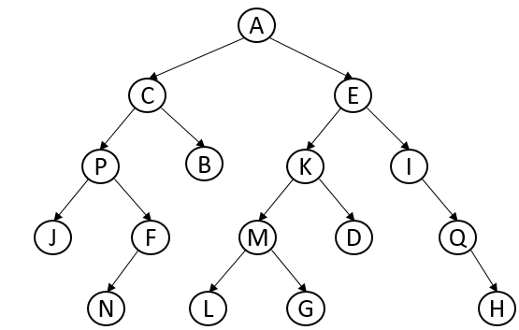
Preorder:
Inorder:
Postorder:

Slide 34
Suppose for a binary tree Inorder and Preorder traversal of a binary tree are d b e a f c g and a b d e c f g .Construct the binary tree and write down it's Postorder traversal .

Slide 35
Construct the binary tree from given traversals and Write the pre order traversal for the tree?
Inorder: J H I B A G D F E C
Post order: J I H B G F E D C A

Slide 36
Construct the binary tree from given traversals and Write the pre order traversal for the tree?
In:KLEFBGCMHIJDA
post:LKFEGMJIHDCBA

Slide 37


